Slide 1
Airborne dust on the tube
Summary of findings by 4Rail Services Ltd
http://www.4-rail.com/environmental_services.asp

Slide 2
Introduction
November 2014 – January 2014
Station staff at 12 stations
Drivers & passengers on 8 lines
“respirable dust (PM10) is considered a substance hazardous to health when present at a concentration in air equal to or greater than 4 mg.m⁻³, as a time-weighted average over an 8-hour period”

Slide 3
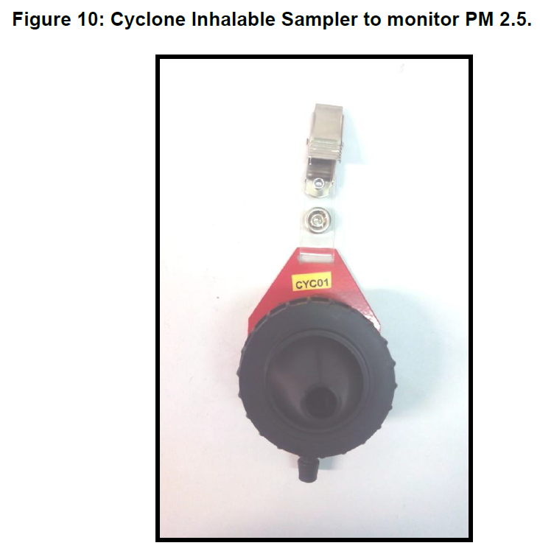
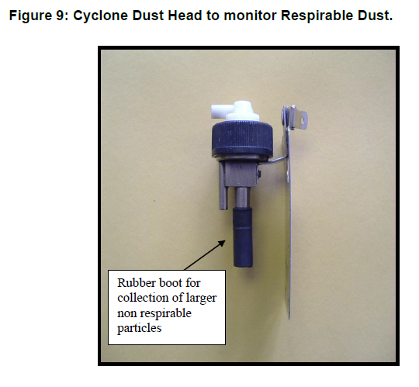
Methods
Train operators:
Three shifts on each line
PM2.5 only done on one of the shifts - Pump with PM2.5 cyclone inhalable sampler (shown right)
GRIMM light scattering device also used for size fractions
Passengers:
One set of journeys on each line
Minimum of 4 hours
Filters:
“The personal samples were collected on 25 mm glass fibre type A/E filters for gravimetric analysis or 37 mm glass fibre type A/E filters for gravimetric analysis and subsequent analysis for metals by Mass Spectrometry; or 25 mm GLA 5000 PVC filters to allow both gravimetric analysis and then subsequent analysis for respirable quartz by infrared spectroscopy “

Slide 4
Methods – Monitoring device
The Grimm laser scatter meter is factory calibrated to a synthetic dust comprising monodisperse 1μm latex and micro Dolomit DR80 polydisperse powder (0.2 – 80 μm).

Slide 5
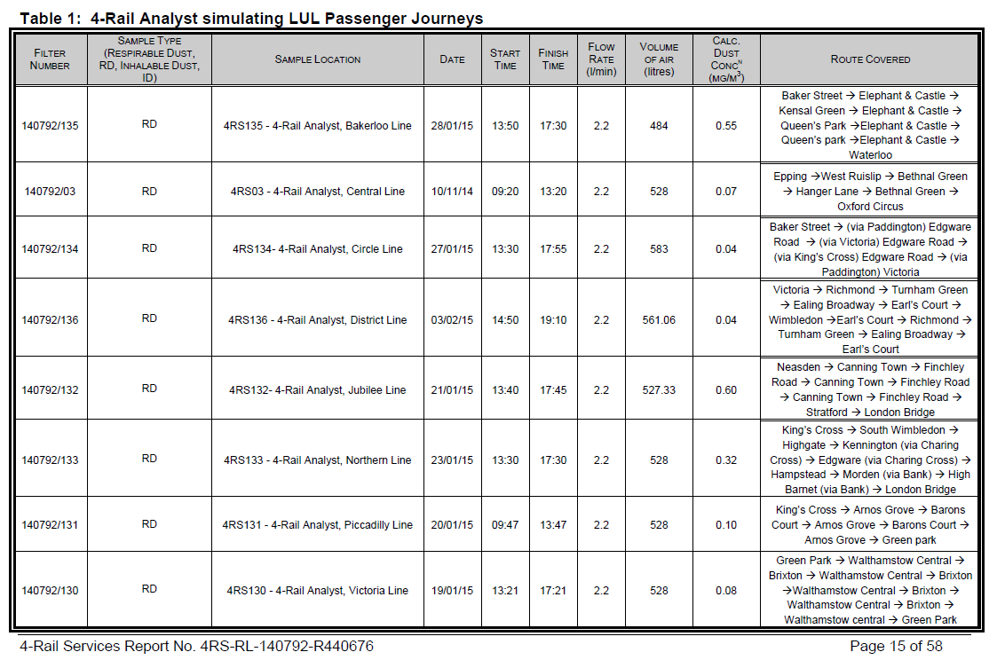

Slide 6
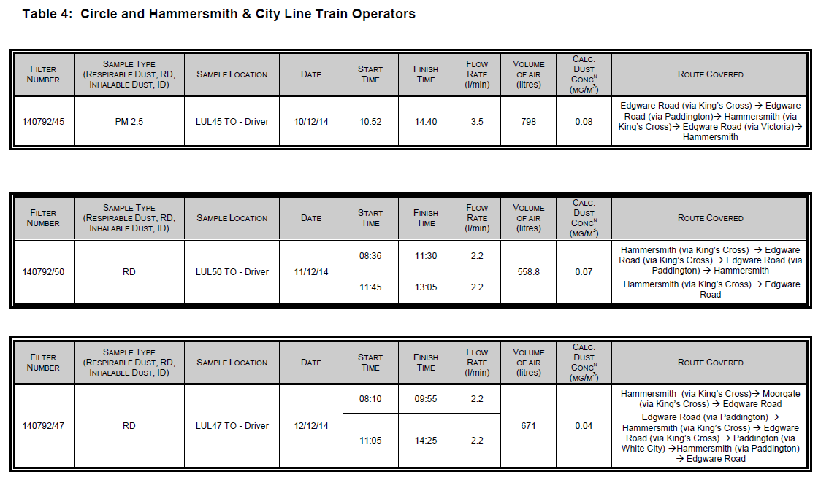
8 hours

Slide 7
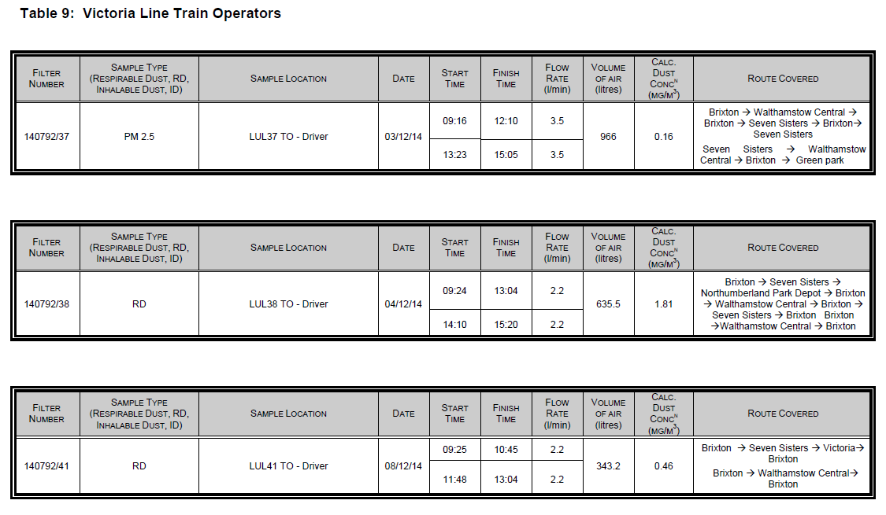
8 hours

Slide 8
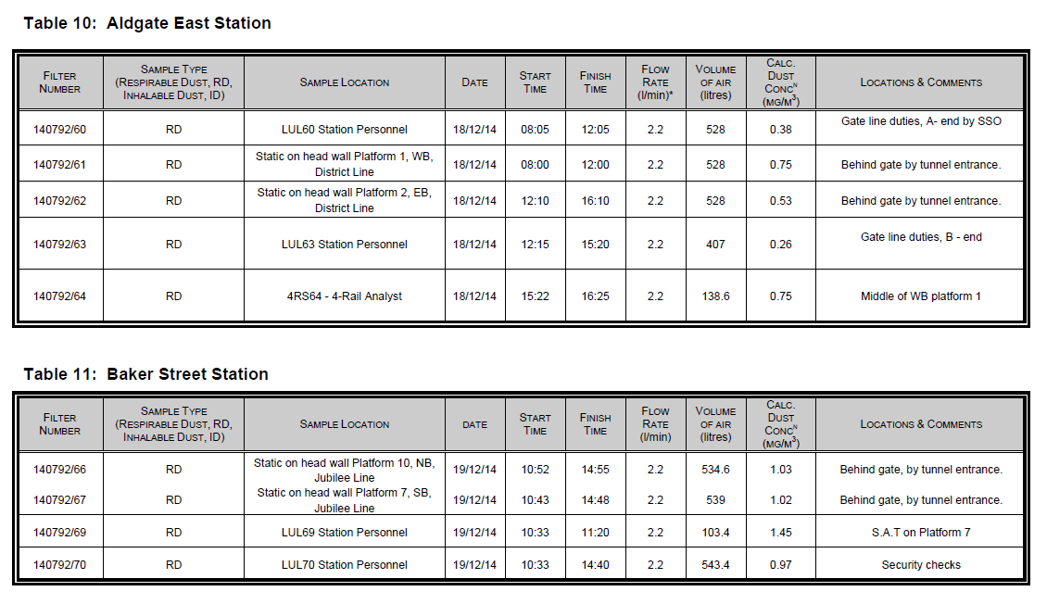

Slide 9
Weighted averages
8-hour workplace weighted average
4 hours at 50 ug/m3
4 hours at 100 ug/m3
(4/8 x 50) + (4/8 x 100) = 75 ug/m3

Slide 10
Results - Passengers
Line | PM10
Bakerloo | 0.55
Central | 0.07
Circle | 0.04
District | 0.04
Jubilee | 0.60
Northern | 0.32
Piccadilly | 0.10
Victoria | 0.08

Slide 11
Results – Station staff
Station | PM10 Personal mg/m3 | Pm10 Static platform mg/m3
Aldgate East | 0.26, 0.38, 0.75 | 0.53, 0.75
Baker Street | 0.97, 1.45 | 1.02, 1.03
Elephant & Castle | 0.18, 0.84, 1.76 | 0.27, 0.29
Euston Square | 0.15, 0.23 | 0.39, 0.61, 0.71
Hampstead | 0.32, 0.47 | 0.27, 0.93
King’s Cross | < 0.02 | 0.05
Oxford Circus | 0.14, 0.50 | 0.31, 0.87
Paddington | 0.25, 0.46, 0.53 | 1.03, 1.07
Piccadilly | 0.16 | 0.21, 0.45
Tottenham Court Road | < 0.02 | 0.14, 0.52
Vauxhall | 0.04, 0.09, 0.14 | 0.33, 0.43
Waterloo | 0.17, 0.32, 0.83 | 0.08, 0.69

Slide 12
Train drivers
Line | PM10 | PM10 | PM2.5
Bakerloo | 0.41 | 0.51 | 0.26
Central | 0.23 | 0.45 | 0.23
Circle & Hammersmith & City | 0.07 | 0.04 | 0.08
District | 0.15 | XX | 0.09
Jubilee | 0.14 | 0.11 | 0.14
Northern | 0.40 | 0.61 | 0.18
Piccadilly | 0.18 | 0.60 | 0.17
Victoria | 0.46 | 1.81 | 0.16

Slide 13
Discussion / Conclusions
The levels of airborne respirable dust for the personal samples taken on Train Operators and on 4-RAIL analysts undertaking passenger journeys travelling on the following lines: Bakerloo, Central, Circle and Hammersmith & City, District, Jubilee, Northern, Piccadilly and Victoria, and were all below the Workplace exposure limit of 4 mg/m3 for respirable dust (long-term 8 hour time weighted average).
But they didn’t do 8 hours of passenger journeys?
Large variation depending on bits of lines
Limits / levels / Serious damage to body.

Slide 14
Discussion / Conclusion
The levels of airborne respirable dust measured for personal samples taken on staff carrying out platform/gate line/station check duties as part of their shifts at the following stations: Aldgate East, Baker Street, Elephant and Castle, Euston Square, Hampstead, King’s Cross, Oxford Circus, Paddington, Piccadilly Circus, Tottenham Court Road, Vauxhall and Waterloo were all below the Workplace exposure limit of 4 mg/m3 for respirable dust (long-term 8 hour time weighted average).

Slide 15
Discussion / Conclusions
The results of the static samples on the platforms would suggest that personal exposure to respirable dust on the platforms would be below the Workplace exposure limit for respirable dust of 4 mg/m3 (long term 8 hour time weighted average). The higher results were for the Jubilee, Northern and Bakerloo platforms at Baker Street, Hampstead and Paddington Stations respectively.

Slide 16
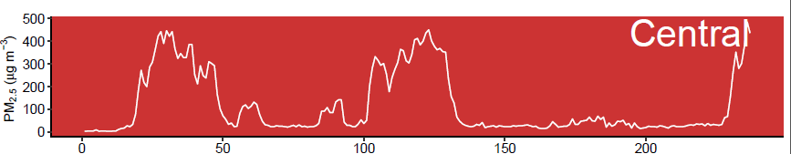
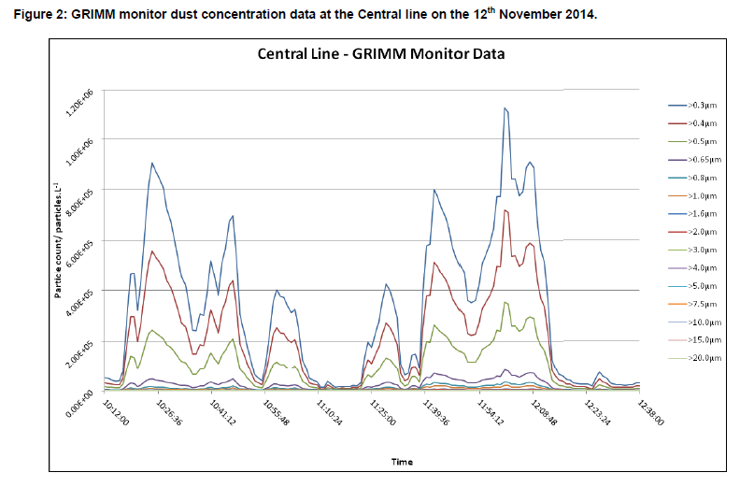
Central line

Slide 17
Discussion / Conclusion
Above ground? 2014 mean of around 0.015 mg/m3
Factors of ten higher than background concentrations outside
Calibration of the GRIMM?

Slide 18
